Slide 1
INFO 5100
Application Engineering & Development
HealFlow Boston
TEAM 38
By
Renuka Alakunta - 002299744
Srivarini Mandali - 002299081
Rushitha Akula - 002837123

Slide 2

Project Overview
1.Our HealFlow Application functions as a Java Swing application that oversees the management of hospital affairs, ambulance services, diagnostics, and pharmacy operations.
2.It presents a user-friendly interface for the efficient administration of patient information, appointment scheduling, and medical records across all healthcare entities.
3.The ambulance service module ensures real-time tracking and monitoring of ambulance availability, dispatch operations, and the conveyance of patients to and from the hospital.
4.The diagnostics section delivers laboratory services and medical testing facilities, while the pharmacy component incorporates an extensive inventory management system.
5.HealFlow is equipped with robust security features to safeguard patient data from unauthorized access.
Problem statement
HealFlow is solving the problem of disjointed healthcare systems by providing a comprehensive solution that integrates hospital management, ambulance services, diagnostics, and pharmacy operations into a single platform. It streamlines healthcare operations and enhances patient outcomes by providing real-time tracking and monitoring, inventory management, and secure access to patient data across all enterprises when deemed necessary. This helps to improve the overall healthcare experience for both patients and healthcare providers.

Slide 3
Project Structure
Enterprises
Ambulance
Hospital
Diagnostics
Pharmacy
Organizations
Ambulance drivers
Ambulances
Diagnostic machine vendors
Medical Companies
Medicine Stores
Pharmacists
Diagnosticians
Roles
Doctor
Receptionist
Main System Admin
System Admins of 4 enterprises
Pharmacist
Patient
Diagnostician
Ambulance POC
Ambulance drivers

Slide 4




Implementation

Slide 5
Significance and role of enterprises
Hospital enterprise
The hospital is an integral part of the broader HealFlow Ecosystem, acting as the main point for delivering healthcare and medical services. Within this ecosystem, the hospital is responsible for crucial functionalities like managing patient records, organizing appointments, and overseeing medical supplies. These are critical for the smooth operation of hospital services. Additionally, the hospital is key in fostering effective communication and collaboration with interconnected services such as ambulance operations, diagnostic centers, and pharmacies, which is essential for providing prompt and well-coordinated care to patients. In essence, the hospital's role is central in the HealFlow Ecosystem, being the cornerstone for providing healthcare and medical attention to those in need.
Ambulance enterprise
The ambulance enterprise is a critical component of the HealFlow Ecosystem as it provides emergency medical services and ensures timely transportation of patients to and from the hospital. The ambulance service component of the ecosystem offers monitoring of ambulance availability, dispatch, and transportation, which helps to improve response times and reduce patient waiting times. The ambulance enterprise also works closely with the hospital to coordinate patient care, ensuring that patients receive the appropriate medical attention and treatment as quickly as possible. Overall, the ambulance enterprise plays a vital role in the HealFlow Ecosystem by providing emergency medical services and ensuring seamless transportation of patients to and from the hospital.

Slide 6
Significance and role of enterprises
Diagnostics enterprise
The diagnostic sector stands as a fundamental pillar within the HealFlow Ecosystem, offering vital laboratory and testing services. It equips healthcare practitioners with the ability to swiftly and precisely ascertain medical issues, a step that is indispensable for administering correct treatments and care. Such diagnostic capabilities are key to elevating the standard of healthcare and improving patient health outcomes. Furthermore, the diagnostic sector maintains a collaborative relationship with the hospital sector, ensuring that the patient care process is both cohesive and effective. In sum, the diagnostic sector's role is pivotal in the HealFlow Ecosystem, as it underpins essential laboratory services and supports the accurate identification and management of health conditions.
Pharmacy enterprise
The pharmacy division is an indispensable segment of the HealFlow Ecosystem, tasked with the meticulous management of medical supplies and pharmaceuticals. It empowers medical professionals to adeptly handle prescriptions, maintain medication inventories, and oversee dispensation, thereby ensuring patients receive the requisite drugs and medical products for their treatment. Engaging in close collaboration with the hospital and associated entities, the pharmacy division ensures a smooth and efficient process for filling medication orders. This collaboration is pivotal for enhancing patient health outcomes, upholding medication safety, and fostering adherence to prescribed therapies. In essence, the pharmacy division is key to the Hospital Ecosystem, delivering crucial services in inventory management and pharmaceutical care.

Slide 7

Use cases of the project
USE CASES OF HEALFLOW PROJECT IN REAL-LIFE
Patient management: healthcare providers can manage patient data, appointments, and medical records across all enterprises in the ecosystem.
Ambulance service: tracking and monitoring of ambulance availability, dispatch, and transportation of patients to and from the hospital.
Laboratory services and medical testing: the diagnostics component provides laboratory services, test results management, report generation, and record maintenance.
Medication management: the pharmacy component provides a comprehensive inventory management system for medical supplies and medicines, including stock management, procurement, and sales.
Security and privacy: the HealFlow Ecosystem includes robust security features, such as user authentication, to protect patient data from unauthorized access.

Slide 8
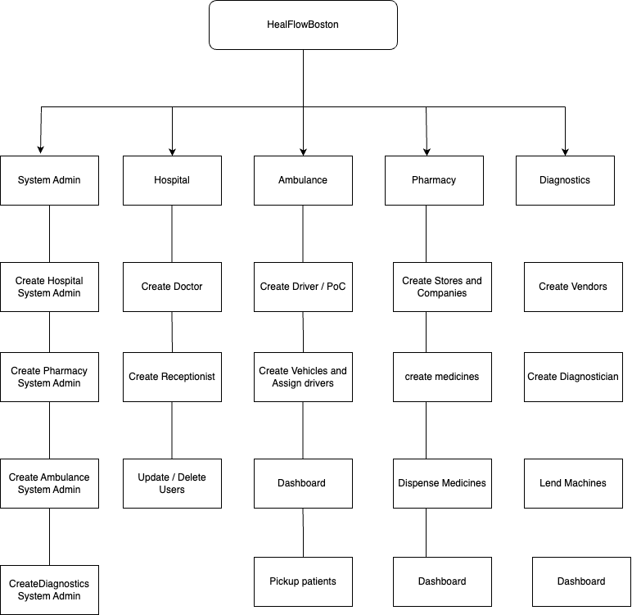
Architecturediagram

Slide 9
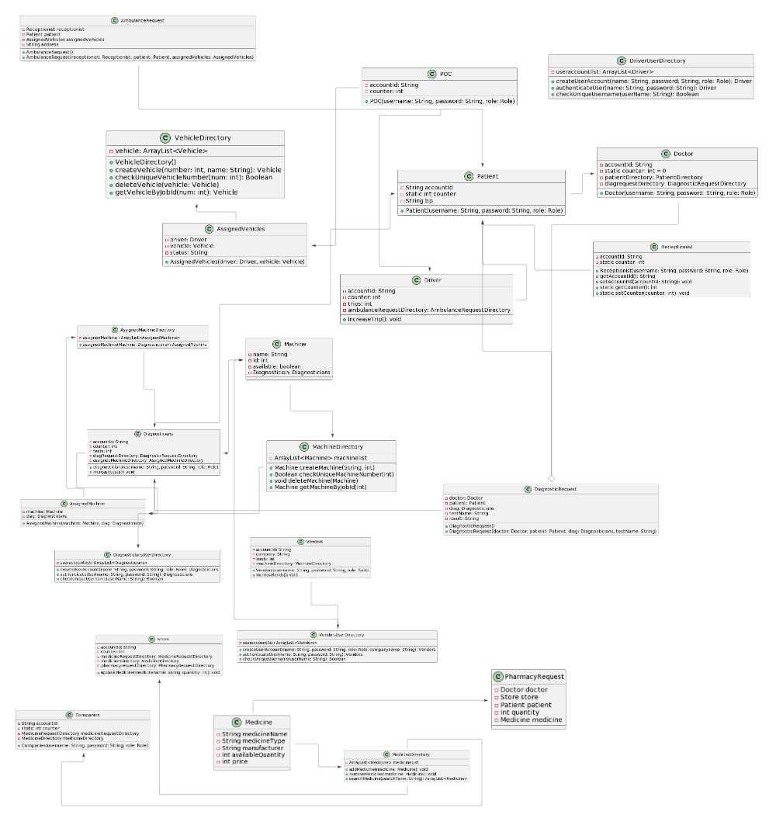
UML Class diagram

Slide 10
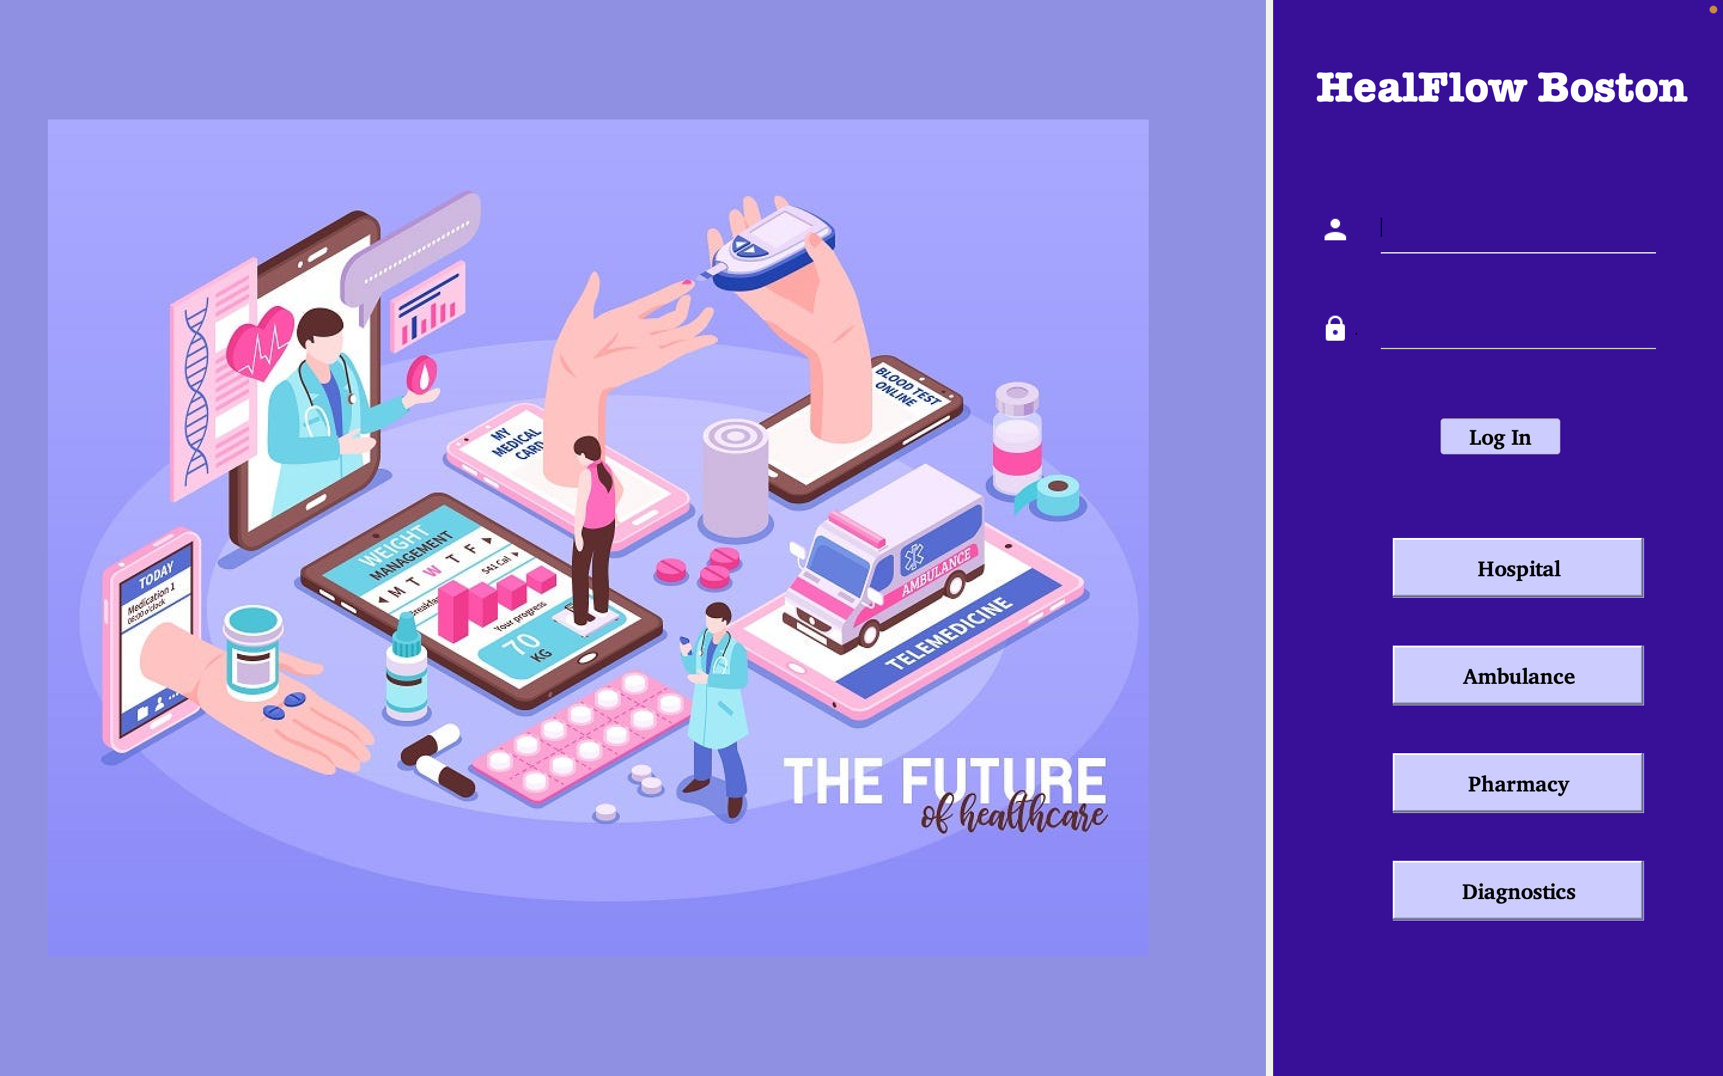

Slide 11
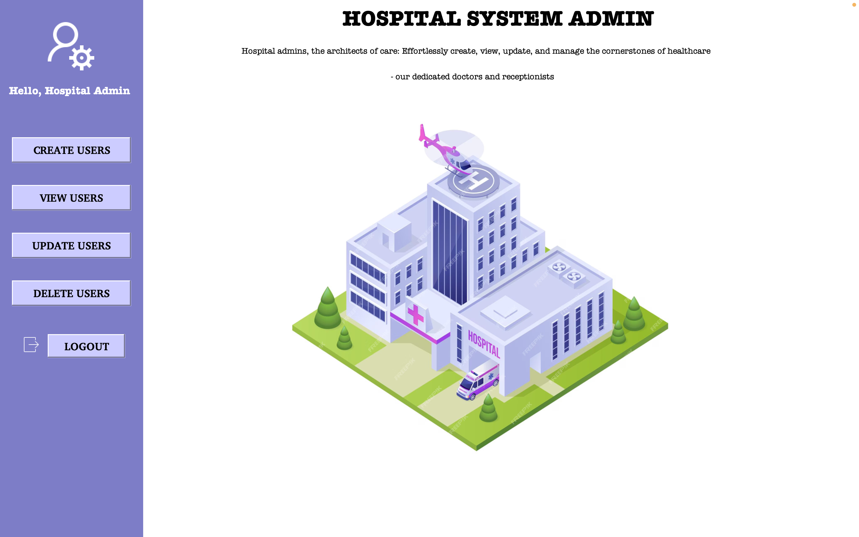

Slide 12
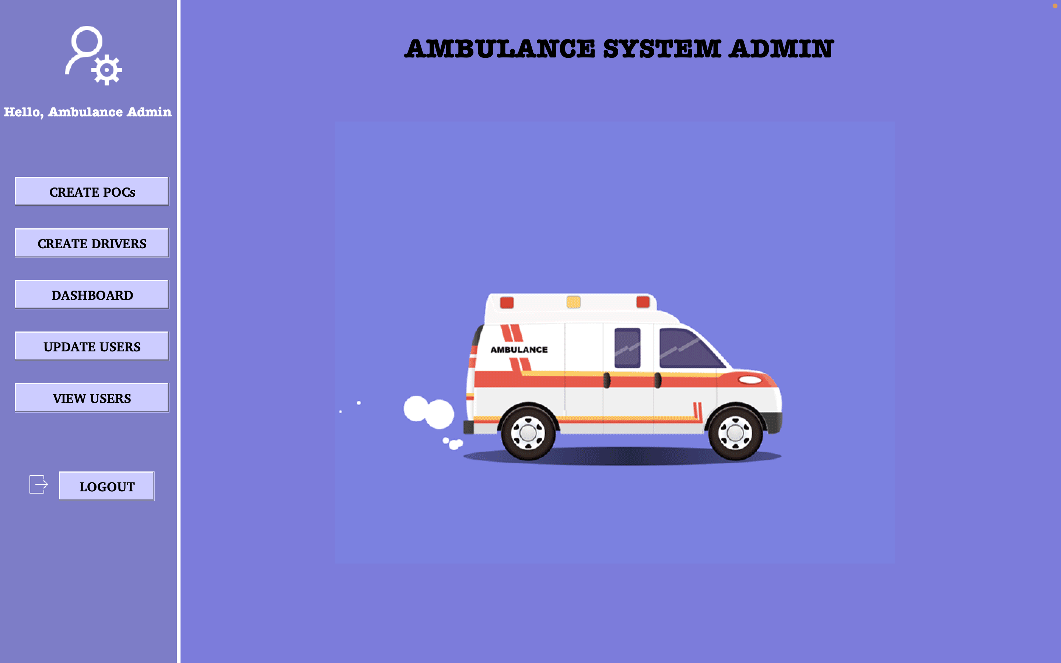

Slide 13
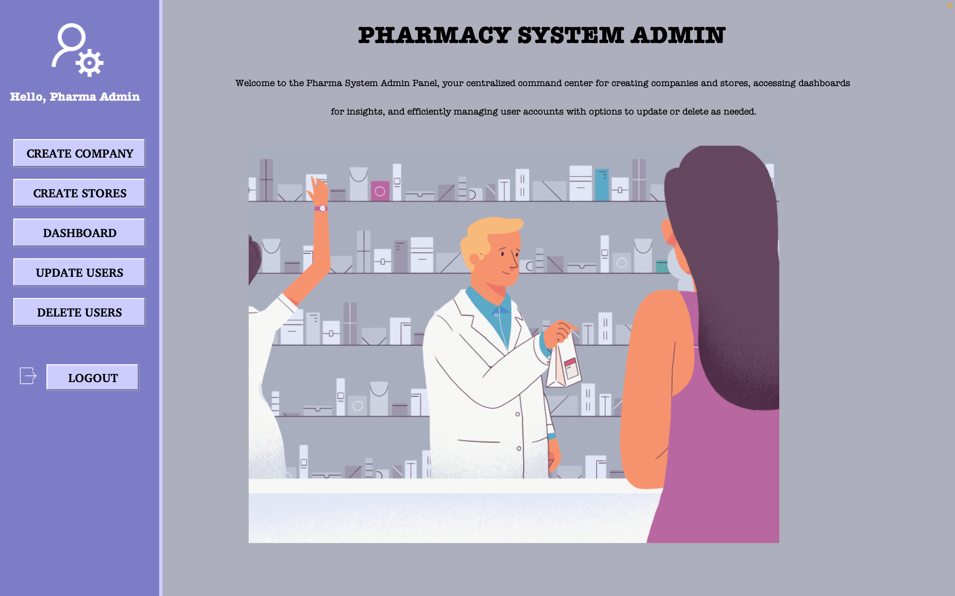

Slide 14
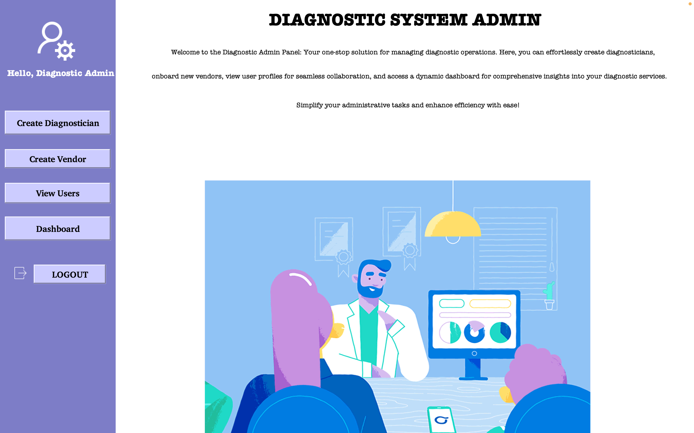

Slide 15
Players and contributions
Renuka Alakunta: Pharmacy enterprise, Diagnostics enterprise
Rushitha Akula: System Admins, Presentation, Architecture Diagram , UML Diagram
Srivarini Mandali: Ambulance enterprise, Hospital Enterprise

Slide 16
Thank you

